Slide 1
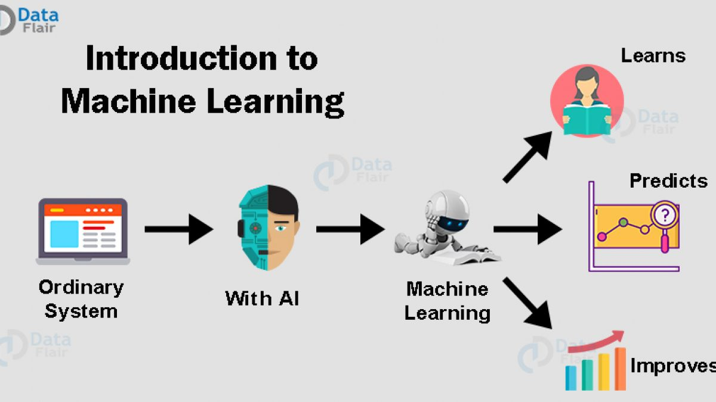
Machine learning project
Name student:
mOhammad alshahrour

Slide 2


Slide 3
Dataset:
-We used dataset about Survived on Titanic Ship of 419 people are in ship in 1985, from kaggle.com
-After we discover the dataset we found that the data have a lot of
null value in column cabin.

Slide 4
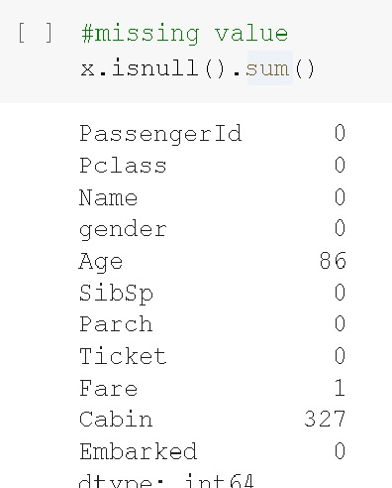
Data set and Cleanup:
-First we choose output columns survived and input is all columns except output
-second we calculate missing value and there is NAN in column one:Cabin is 327 null value in column two:Age is 86 null value and fare is 1 null value

Slide 5
Data set and Cleanup(cont.)pre processing:
-Third we imputer null value with sklearn library we use simple imputer because
Version in google collab run on this and we use column age to imputer it
-fourth we drop row that contains null value in cabin and fare columns
-Fifth we use label encoder from sklearn library to change value of column gender male and female to 0 and 1
-six we use one hot encoder from sklearn library to change value of column Embarked of (S,Q,C)TO(0,1,0) one represents of each array to choose S OR Q OR C in 0 and 1

Slide 6
Data set and Cleanup(cont.)visulaization:
-seventh we plot 10 sketch to visualization the all of dataset

Slide 7
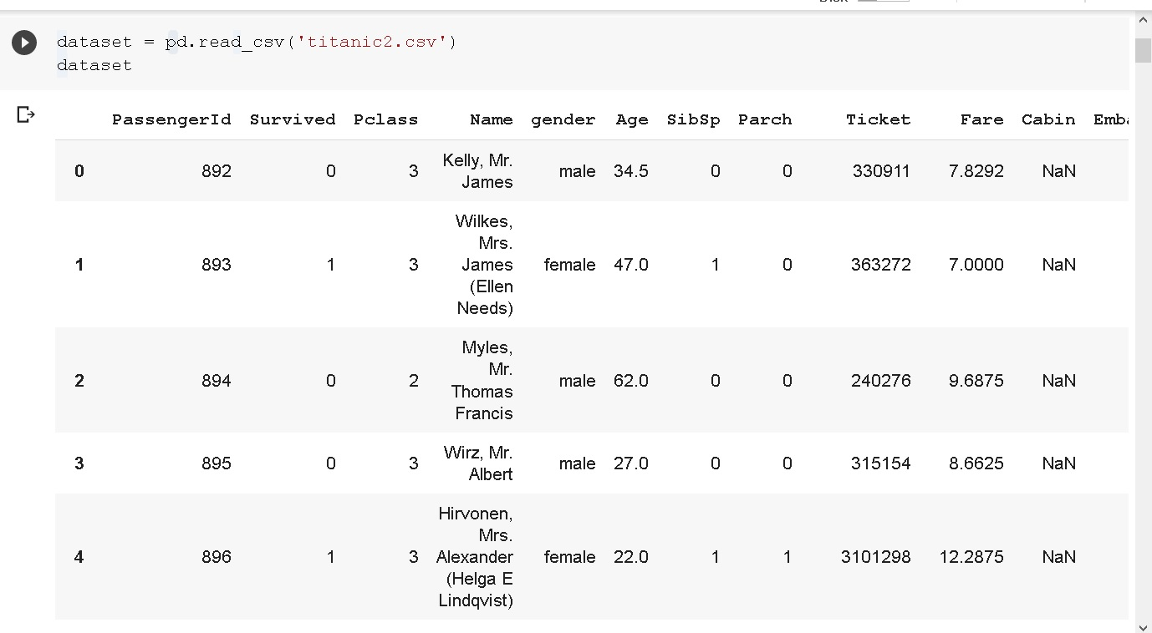
Screenshot of dataset:

Slide 8
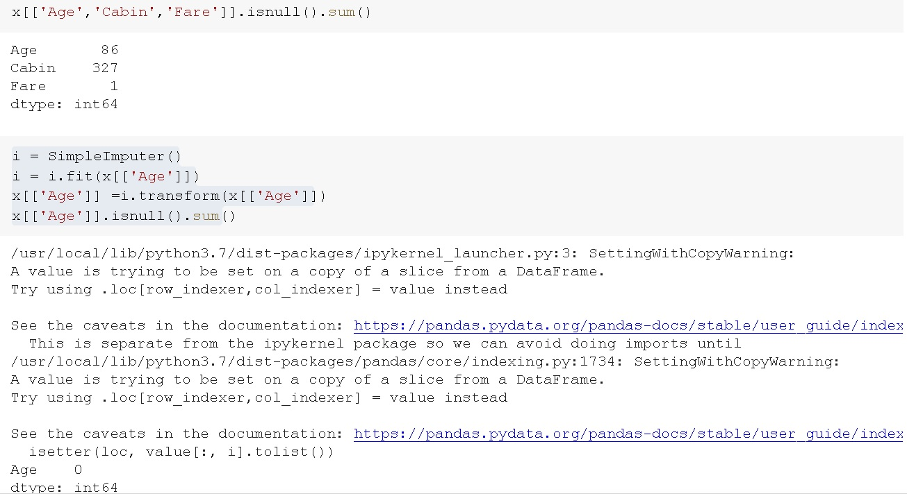
Screenshot of code:

Slide 9
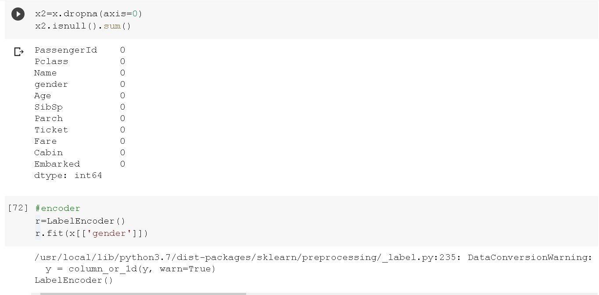
Screenshot of code(.cont):

Slide 10
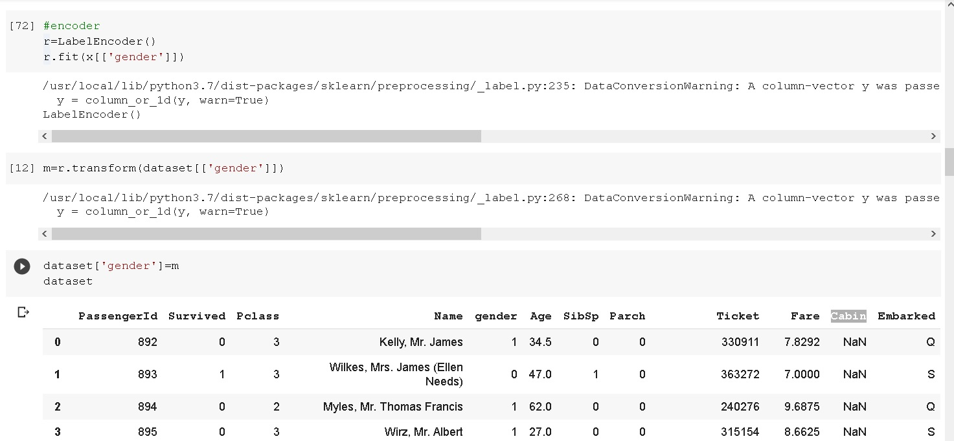
Screenshot of code:

Slide 11
Algorithms Supervised:
-Decision Tree
-KNN
-SVM
-RandomForest
-Logistic regression

Slide 12
Algorithms UNSupervised:
-K-MEANS
-DBSCAN
-Agglomerative

Slide 13
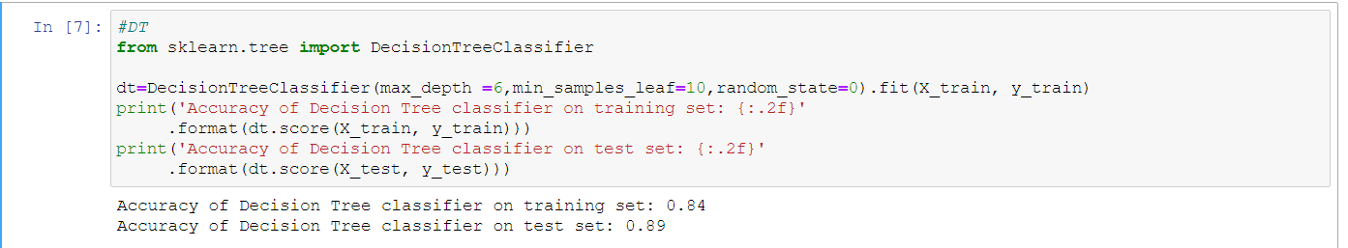
Decision Tree:
-We found the Decision Tree is best Solution that we tried.
-It scored 89%

Slide 14
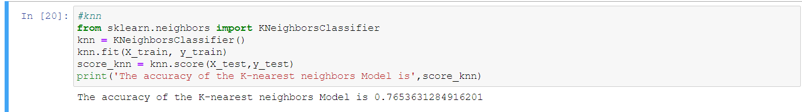
Knn:
We implemented KNN with faith that it will fail because the data does’nt alike to each other.
Indeed, We found a very surprising result, We trained the KNN Regression in neighbors, Then Finally The Best N Value is 0.7

Slide 15
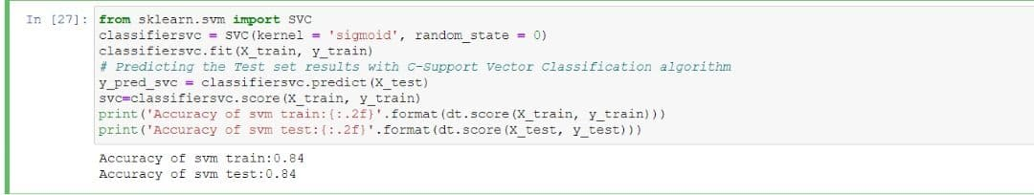
SVM algorithm:
We Used SVR to implement SVM algorithm
SVR reached 84% as the highest attempt

Slide 16
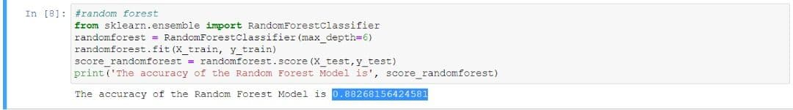
Random forest:
-We chosen depth max =6 because we use 6 columns in dataset
--It scored 88%

Slide 17
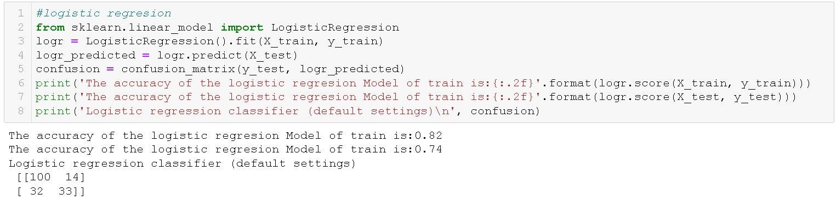
Logistic regression:
-we apply confiusion matrix on logistic regeression
-we score on train and test is in train 82%,test:74%

Slide 18
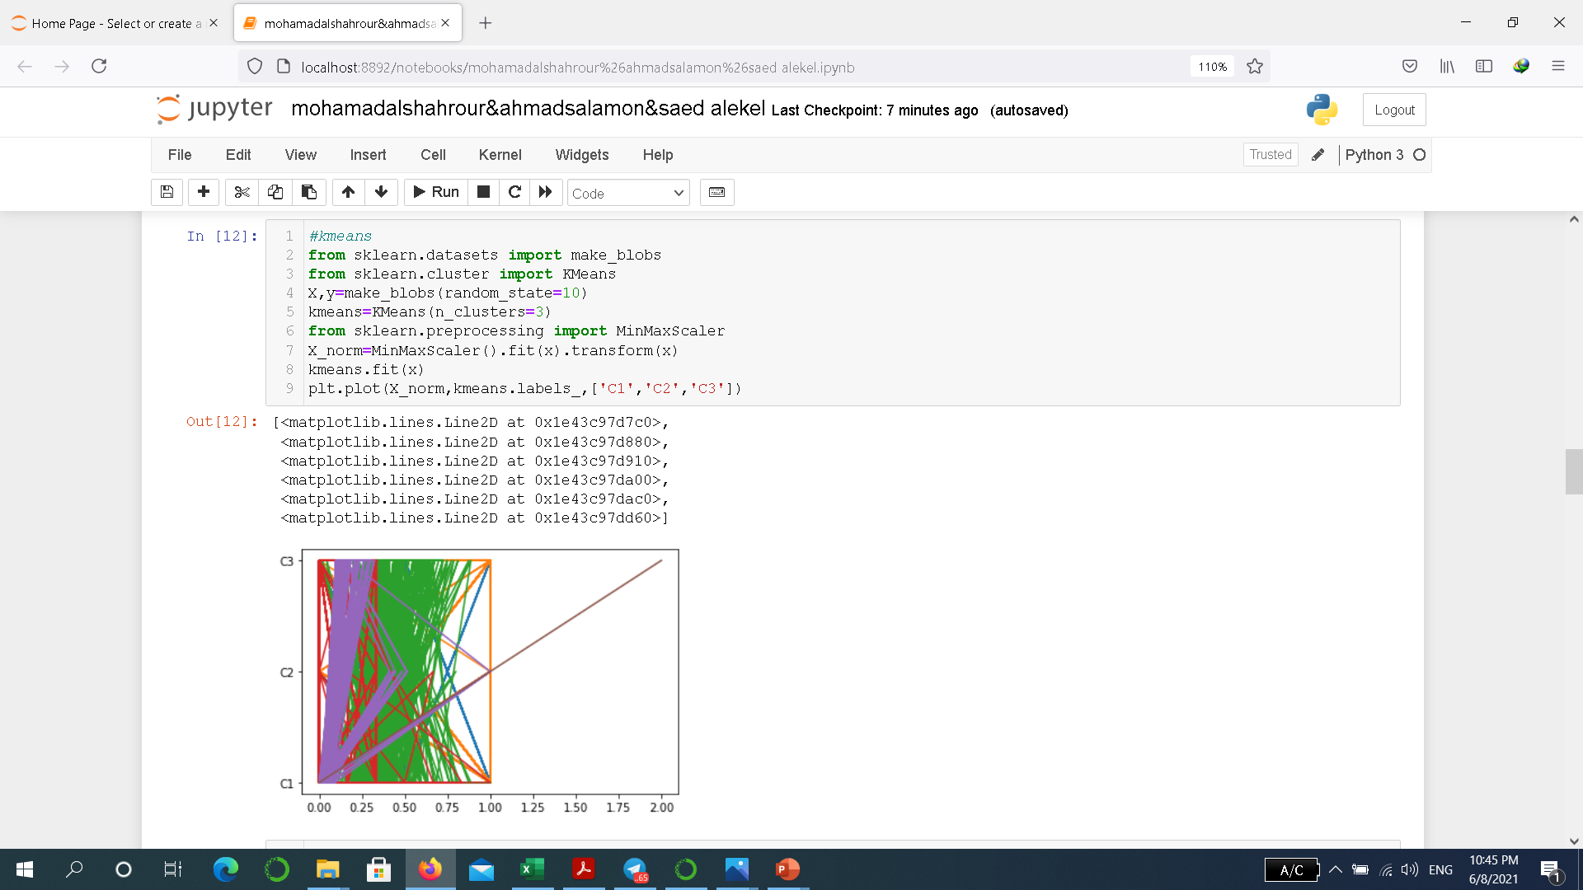
K-means unsupervised algorithm:
-we take 3 number of clustering
-And we draw 3 clustering c1,c2,c3

Slide 19
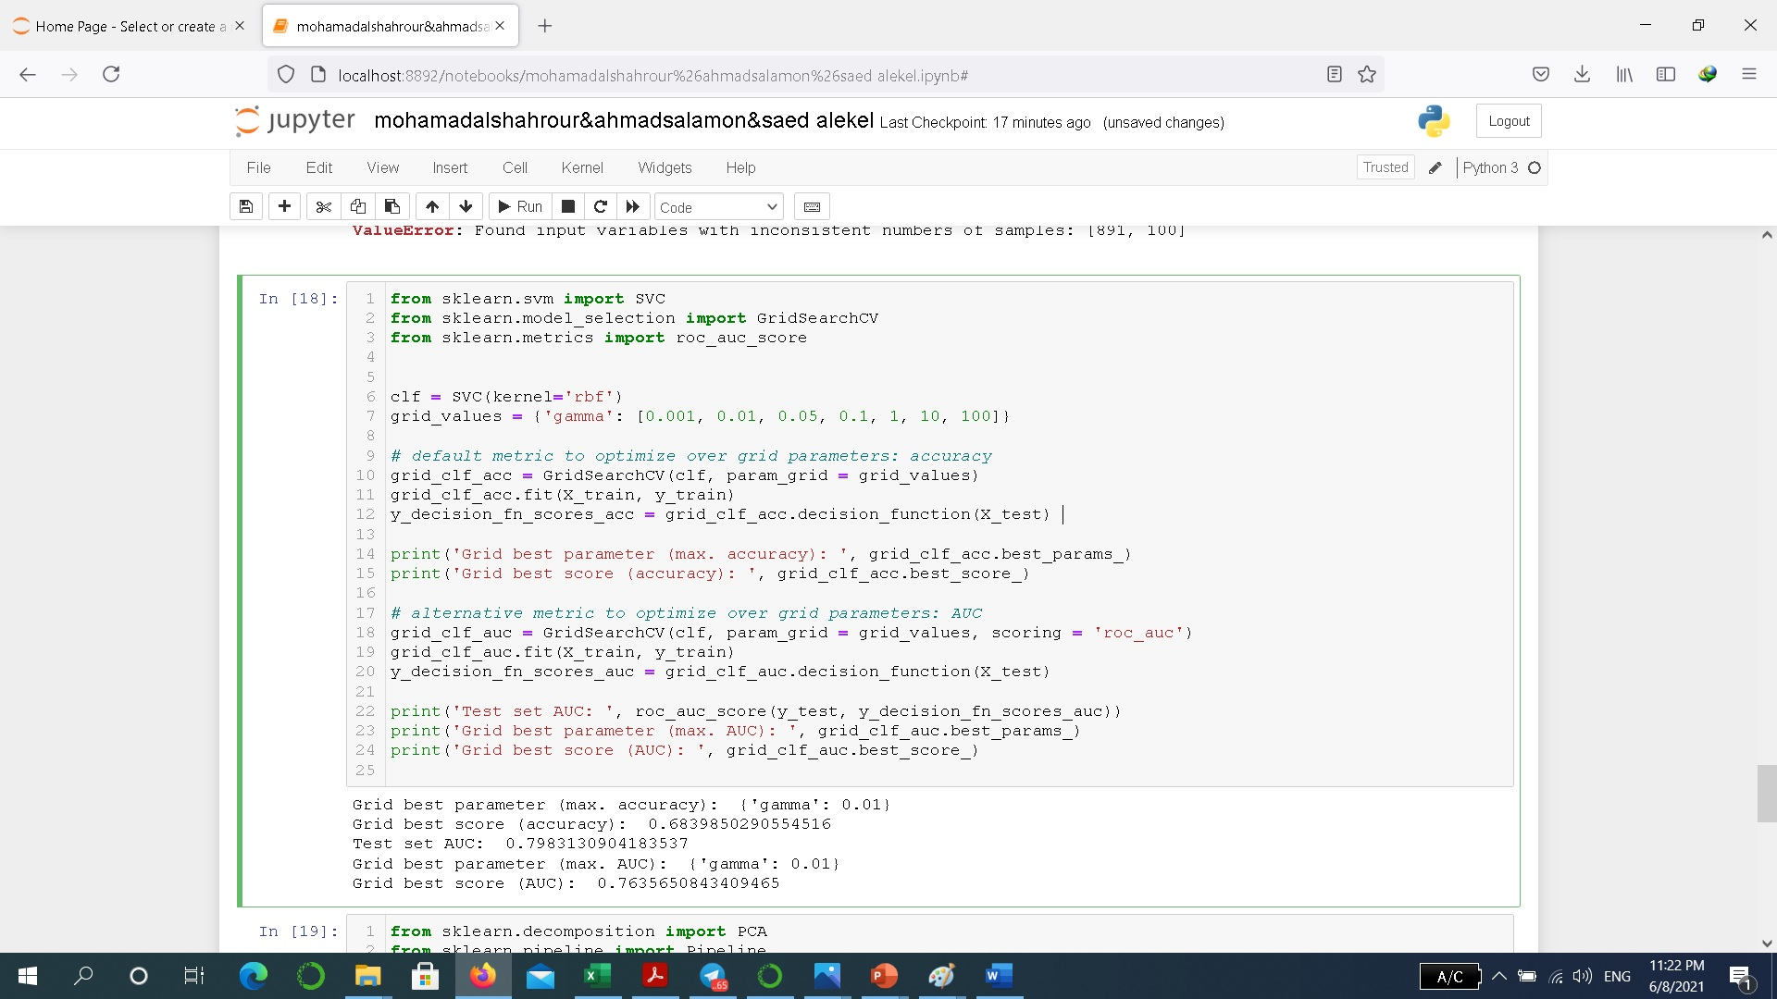
Grid search:

Slide 20
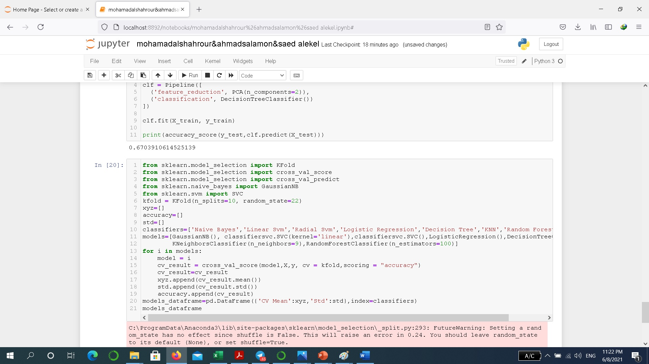
K-fold:

Slide 21
Comparing:
After implementing all the above algorithm we found that DecisionTree and random forset are the best for our case because we get best score near to one

